Slide 1
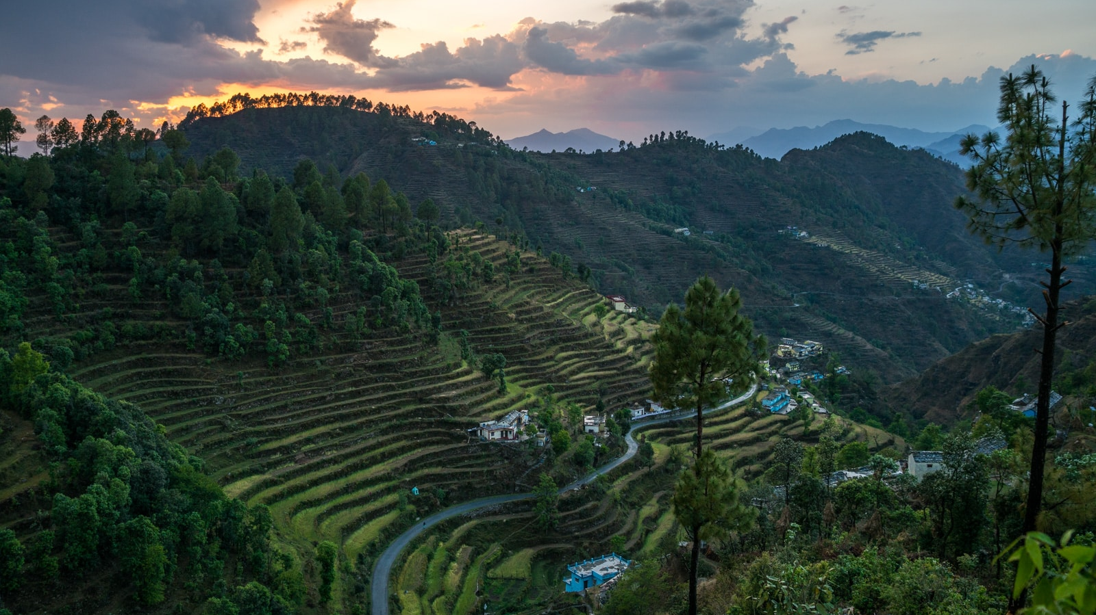


Project Management Taught by Prof. Natalia Efremova
IMPLEMENTATION OF SUSTAINABLE AGRICULTURAL SOLUTIONS

Slide 2

TABLE OF CONTENTS
Project Scope
Background – Industry
Deliverables – Proposed Solution
Background – SWOT
Background – Target Place
Background – Key Problem
Raising Capital
Project Phase 1, 2 and 3 – Research | Planning | Deployment / Implementation
Project Phases
Methodology – How and Why
Business Model Canvas
Methodology – Roles
Risks
Budget and Timeline of the Project
Risk Factor Score

Slide 3

PROJECT SCOPE
Objective:
Implementation of sustainable agricultural solutions
Problem:
Declining farming activities along with low yield and profitability,
poor availability of technology, climate change,
unbalanced migration to overly populated urban cities, less job opportunities, inequality and disparity
Proposed Solution:
Integrated farming - Promote organic, innovative and green source farming
Increase the use of smart technological tools, data in agricultural practices
Outcome:
Increase sustainability, improve economy, preserve indigenous culture
Increase employment, profitability and value of yield through scalable solutions
Source:
[1] Decline in Budget allocation for agriculture disappointed many: Devegowda | Business Standard News (business-standard.com)
[2] Climate change forces Uttarakhand farmers to migrate (thethirdpole.net)
Notes:
Integrated farming is a system which tries to imitate the nature’s principle, where not only crops but, varied types of plants, animals, birds, fish and other aquatic flora and fauna are utilized for production. These are combined in such a way and proportion that each element helps the other; the waste of one is recycled as resource for the other.
here main goal is to save water and recycle it for production.

Slide 4
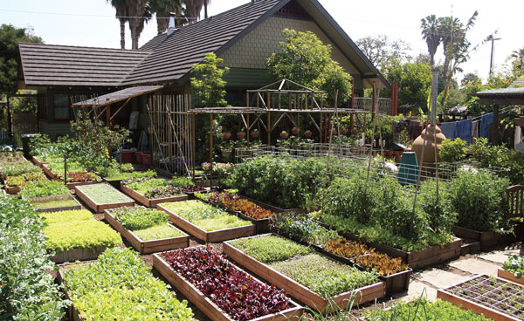
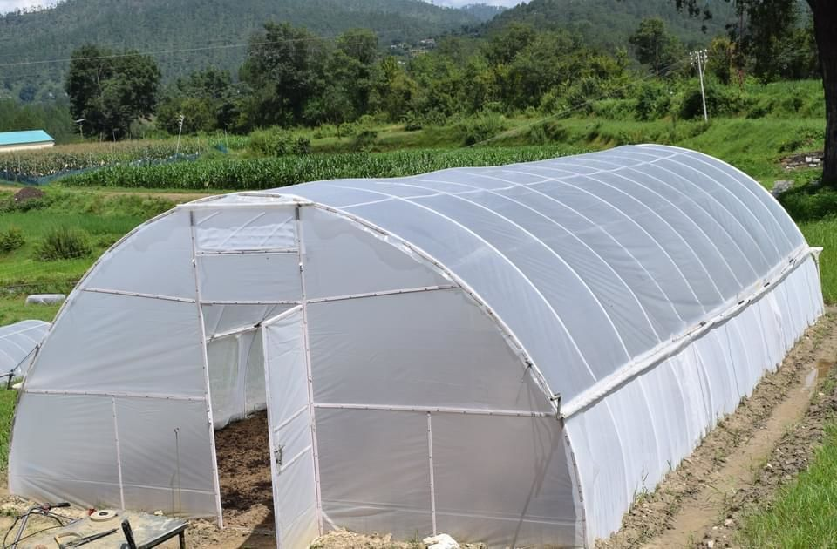
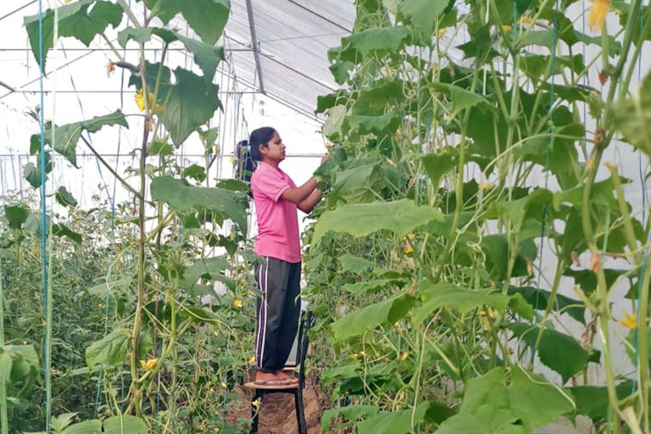
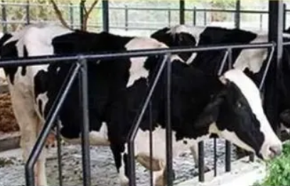
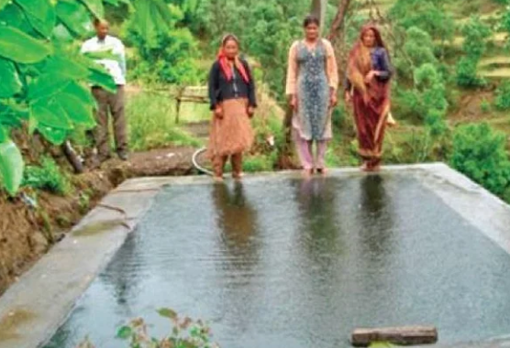
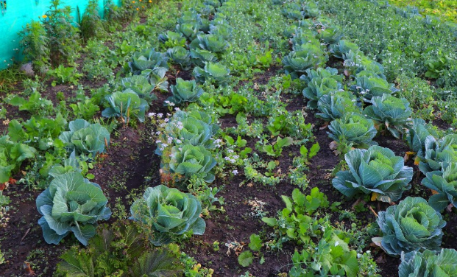

DELIVERABLES - PROPOSED SOLUTION
Integrated farming - Promote organic, innovative and green source farming
Permaculture (Variegate growing vegetables and fruits using integrated cropping techniques like spices and herbs as ancillary
Climate-controlled poly house
Controlling the quality of seeds
Vertical farming
Crop calendar precision planting
Transparent process in organic farming
Animal husbandry, poultry and pisciculture
Spring water management
Source:
[1] Decline in Budget allocation for agriculture disappointed many: Devegowda | Business Standard News (business-standard.com)
[2] Climate change forces Uttarakhand farmers to migrate (thethirdpole.net)

Slide 5

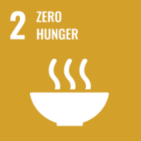




BACKGROUND – INDUSTRY
Among 17 UN SDGs, we focus on 4
Indian economy is agrarian in nature ~ 18% of the GDP
Primary source of livelihood for about 58% of India’s population
CAGR of 10% during 2015-­25 (USD 10.73 billion)
Source:
[1] Decline in Budget allocation for agriculture disappointed many: Devegowda | Business Standard News (business-standard.com)
[2] Climate change forces Uttarakhand farmers to migrate (thethirdpole.net)
[3] Agriculture, forestry, and fishing, value added (% of GDP) - India | Data (worldbank.org)
[4] THE 17 GOALS | Sustainable Development (un.org)
[5] Agriculture in India: Industry Overview, Market Size, Role in Development...| IBEF
Notes:
The compound annual growth rate (CAGR) is the rate of return that would be required for an investment to grow from its beginning balance to its ending one.

Slide 6
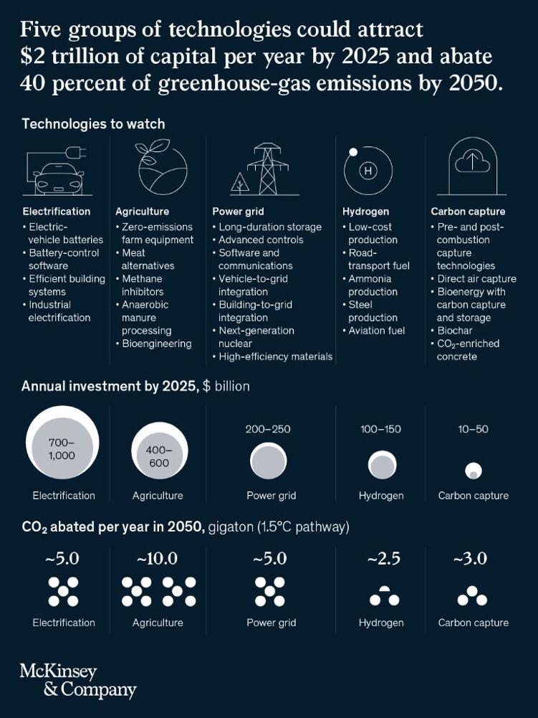
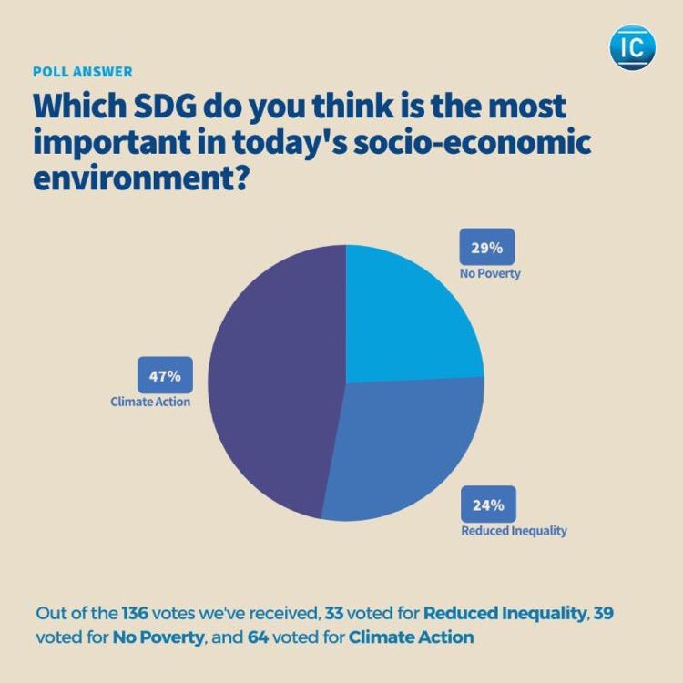
BACKGROUND – INDUSTRY
Increasing Investment and Use of Technology in the Agricultural sector
Source:
[1] Decline in Budget allocation for agriculture disappointed many: Devegowda | Business Standard News (business-standard.com)
[2] Climate change forces Uttarakhand farmers to migrate (thethirdpole.net)
[3] Impact Consulting Survey January 2022
[4] What technology trends will--and should--lead business agendas in 2022? | McKinsey Digital | McKinsey & Company

Slide 7
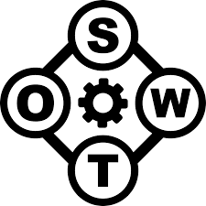
BACKGROUND – SWOT ANALYSIS
Agriculture industry in India
STRENGTHS
• High yields of crop
• Typically, low prices • Cheap labor in countryside • Government support and fundings
WEAKNESS
• Low-value addition and processing
• Post-harvest losses
• No access to modern technology
• Scarcity of skilled labor
THREATS
• Climate change
• Land degradation
• Size of land holdings
• Crop loss due to weeds, insects
OPPORTUNITIES
• Arable land for diversified crops
• High demand of organic produce
• New retailers and food processing
• Agri-business
Source:
[1] (PDF) Agriculture in India: A SWOT analysis (researchgate.net)
[2] Swot Analysis of Agriculture of India | PDF | Agriculture | Food Security (scribd.com)

Slide 8
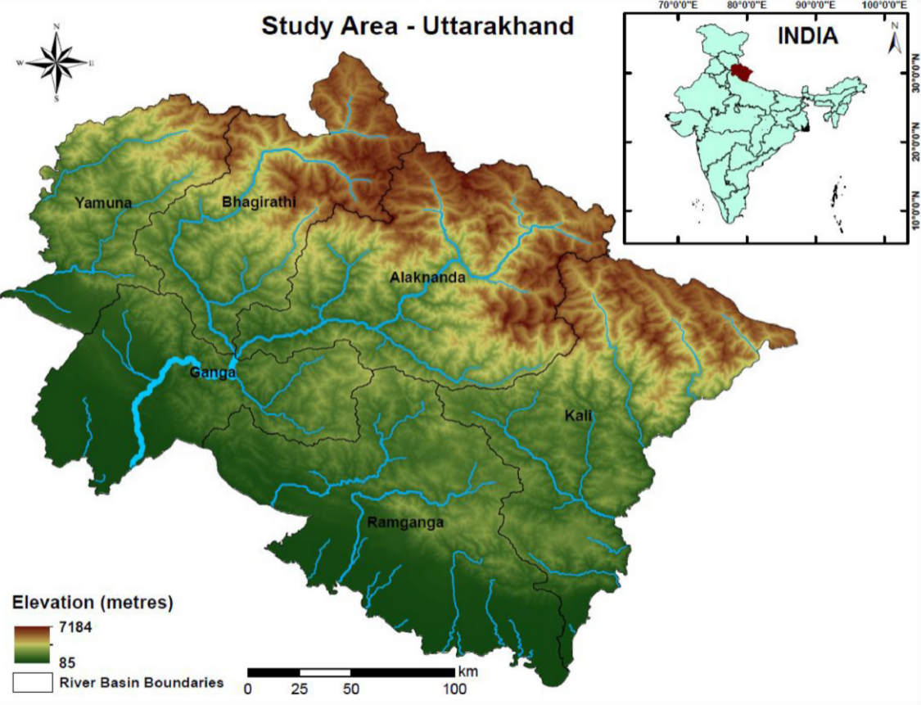
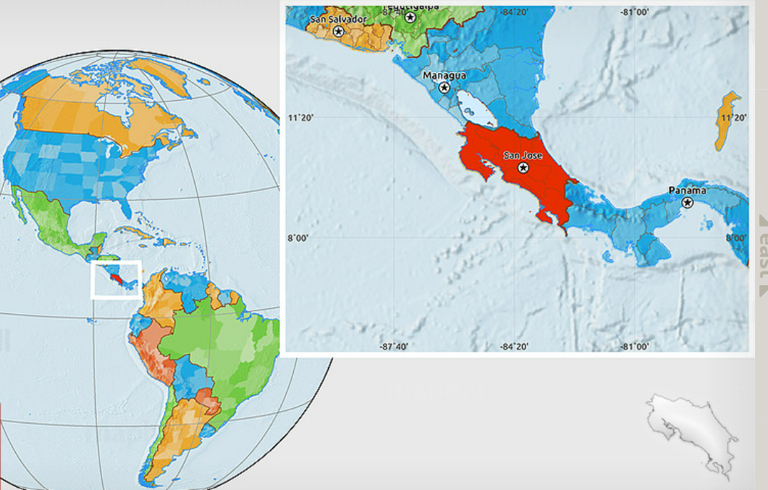

BACKGROUND – TARGET PLACE
Area of Implementation: Uttarakhand, a state in Northern India, area greater than Costa Rica
Uttarakhand – Indian state at the foothills of the Himalayas, sub-tropical climate
>
Source:
[1] Geospatial modelling of soil erosion and risk assessment in Indian Himalayan region—A study of Uttarakhand state – ScienceDirect
[2] Political Location Map of Costa Rica (maphill.com)

Slide 9
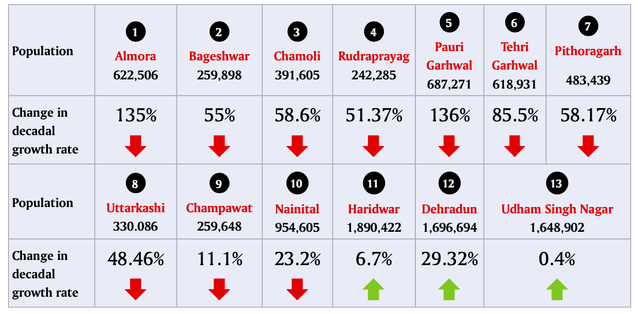

BACKGROUND – KEY PROBLEM
80% of state population survive on agriculture directly or indirectly
However, recent years of climate change and declining yields have forced
Problem 1 - Hill farmers seek alternative livelihoods and migrate to cities
Change in decadal population growth between 1991-2001 and 2001-2011
Source:
[1] Climate change forces Uttarakhand farmers to migrate (thethirdpole.net)
Notes:
There are 13 districts in Uttrakhand except 3 districts it can be observed that there is the mass migration for a better job prospect.

Slide 10
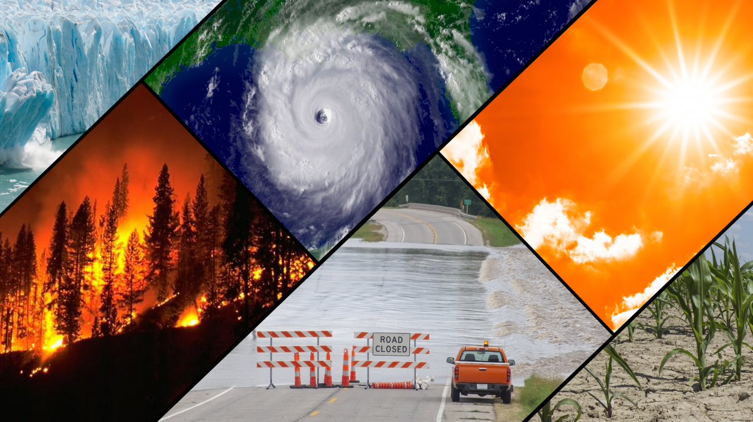
BACKGROUND – KEY PROBLEM
Problem 2 - Climate Change in Uttarakhand increasingly forcing people to abandon farming
Impact of climate change (~1.9 degrees Celsius warmer by 2050)
Changing temperatures
Upward-moving snowlines
Receding glaciers
Erratic rainfall
Reduction of snow in winter
Changed cropping seasons
Shifting cultivation zones for crops
Drying up of perennial streams
Source:
[1] Decline in Budget allocation for agriculture disappointed many: Devegowda | Business Standard News (business-standard.com)
[2] Climate change forces Uttarakhand farmers to migrate (thethirdpole.net)

Slide 11
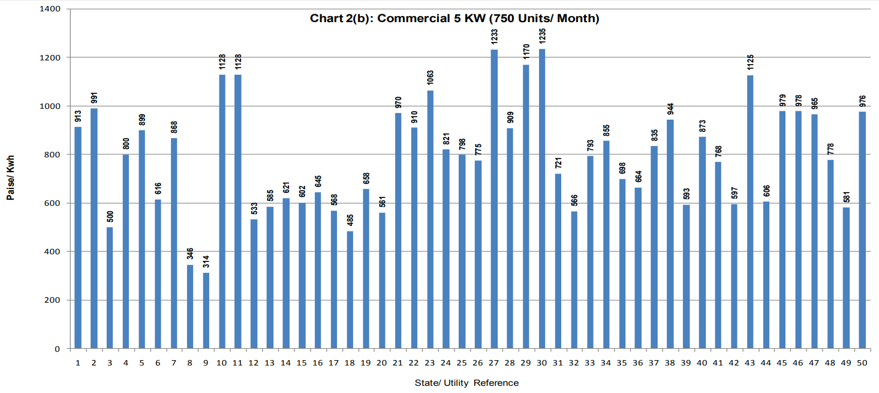
BACKGROUND – OPPORTUNITY
One of the lowest power rates in India
Low land rates
Source:
[1] An analysis of power tariffs across India.pdf (phdcci.in)
[2] tariff_2019.pdf (cea.nic.in)

Slide 12

BACKGROUND – GOVERNMENT POLICIES
Several Cooperative Farmers Welfare Scheme
Pandit Deendayal Upadhyay scheme, the Adarsh Krishi Gramin Yojana
Deendayal Upadhyay SahKarita Kisan Kalyan Yojana
Low interest rate 2%
Soil health card
Direct debit transfer
Free gas connection
Total Foreign Direct Investment (FDI) in state risen to USD 46.7 million Apr’00 - Oct‘09
Source:
[1] https://agriculture.uk.gov.in/pages/show/219-programmes-schemes
[2] India Brand Equity Foundation Slide 1 (ibef.org)

Slide 13
RAISING CAPITAL
Angel Investors/Venture Capitalists
Brand Partnerships
Government Social Welfare Schemes
Bank Loans
Crowdfunding
Celebrities
OPERATING EXPENSES

Slide 14

PROJECT PHASES – THREE
Research
Analyze
Planning
Implement
Deployment
Budget
Survey
Expert Collaboration
Tech
Train
Produce
Process

Slide 15

PROJECT PHASE 1 – RESEARCH
Analyze
Research & Data analysis for targeting regions & market scope, Quality Analysis / Quality Check
Expert Collaboration
Collaborate with partners like universities, research organizations, foundations
Design area infrastructure
Survey
Planning for farming infrastructure
Talks with stakeholders (Local Farmers)
Contractual agreement design
People survey to instill confidence
Creating Farmers Producers Organization
Survey the farmlands and understand local situation and First Risk Assessment
Assess suitability and crop production

Slide 16

PROJECT PHASE 2 – PLANNING
Budget
Budget Analysis
Strategize & Develop a GTM framework for Investors & Government Bodies
Technology
Develop Web tool and App (Features like AR, Remote Sensing prediction AI, Demand planning
Initial Capital Raising, Govt Investor
Contract Design
Second Risk Assessment
Knowledge transfer to on-ground partners
Training
Second round capital raising (bank loans on behalf of farmers)
Social Community Platform
“GHUGHOOTI” app
Creating Informative Media Resources

Slide 17
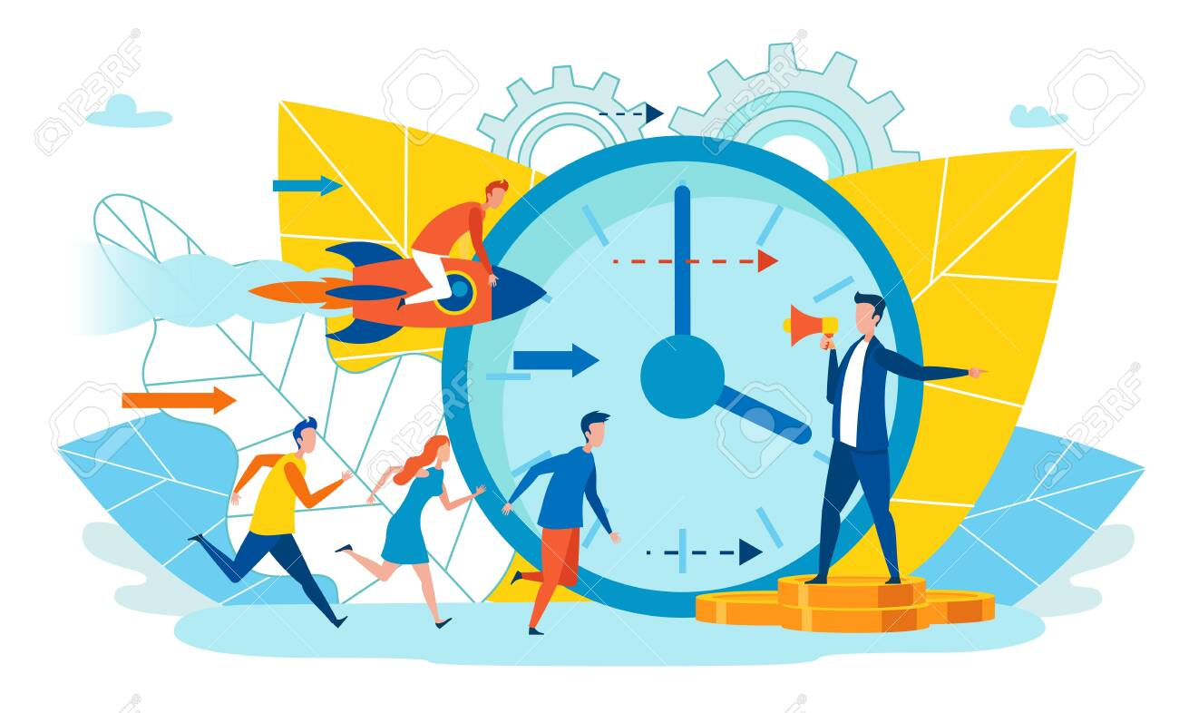
PROJECT PHASE 3 – DEPLOYMENT
Implementation
Prioritization of backlog – task assignment as large project based on received funds
Procurement of raw materials
Vendor Collaboration and Development
Connect with large retailers and distribution partners
Local Bazar (Mandis)
Measurable Execution
Spread awareness and organic marketing activities
Monitor and Control - QA/QC
Sow & Breed the specific crops, poultry, fishes depending on the seasonality and other factors
Produce and Process

Slide 18
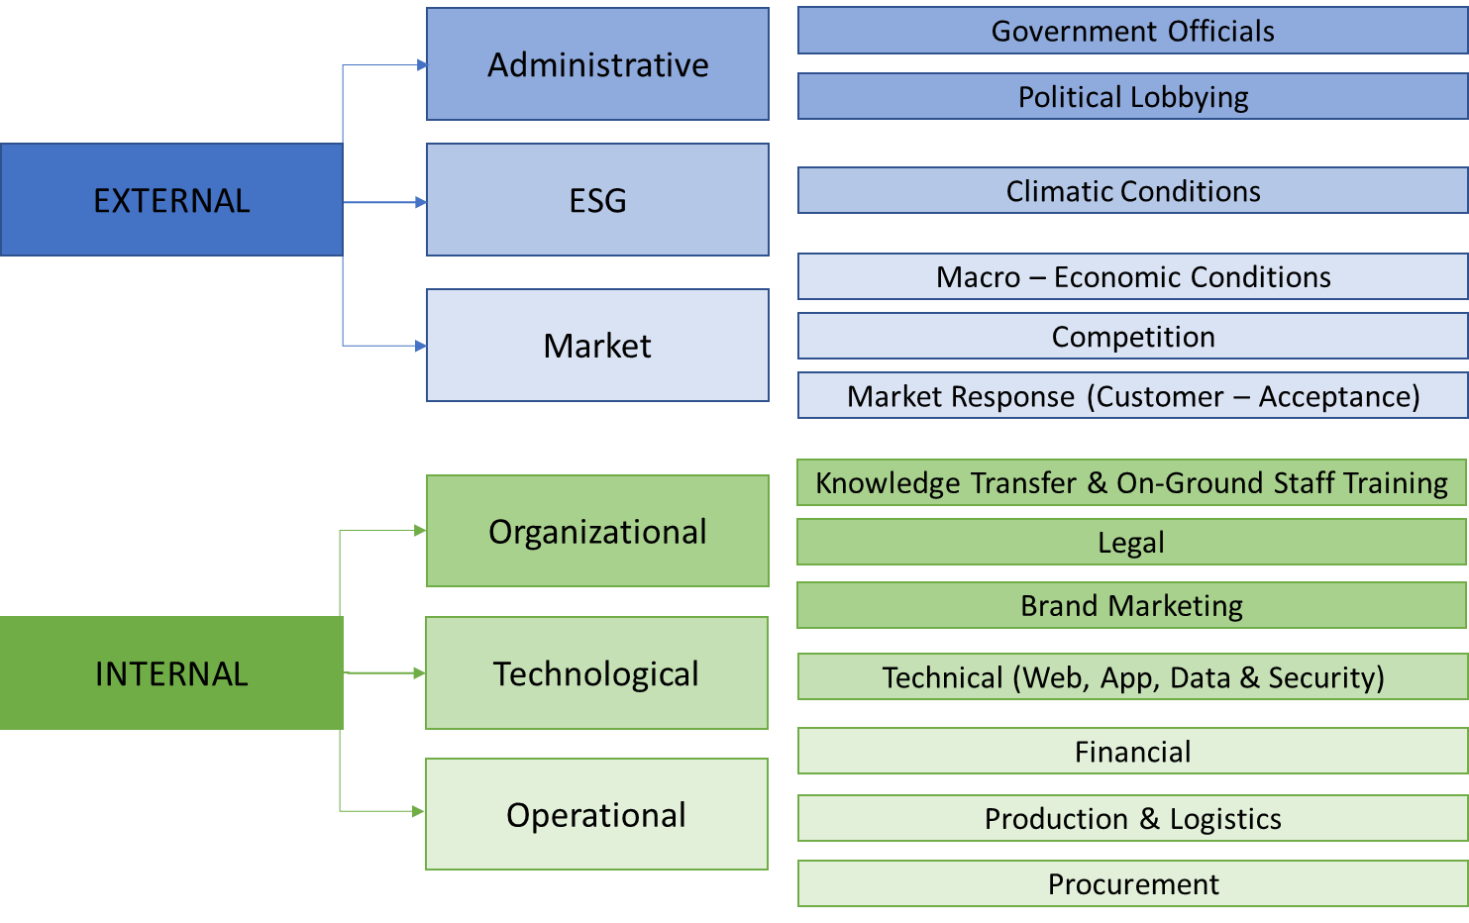
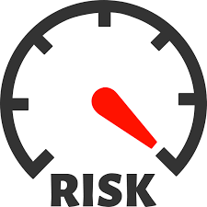
RISKS
Source:
[1] https://esgriskguard.com/all-about-esg-risks/
[2] https://youtu.be/sc9MZ41vIbk
Notes:
Thanks Kirti for giving us a clear explanation of project phases, the next important step is risks

Slide 19
RISK IMPACT MATRIX
Source:
[1] https://esgriskguard.com/all-about-esg-risks/
[2] Iterative Model - YouTube

Slide 20
RISK FACTOR SCORE
Risk Factor Score =
(Score of Consequence + Score of Likelihood) - (Score of Consequence * Score of Likelihood)
Risk Factor Score = Average Score Sum – Average Score Multiplied
Risk Factor Score = (5.42+3.71) – (5.42*3.71)
Risk Factor Score = -11.02
This is out of a total score of -80
Therefore, as per our calculations, 11.02/80
= 13.77% is the Overall Risk Factor Score Percentage
Source:
[1] https://esgriskguard.com/all-about-esg-risks/
[2] Iterative Model - YouTube

Slide 21

BUDGET AND TIMELINE
All figures are in INR
INR 7 Million ~ GBP 70,000
LINK TO THE TIMELINE AND BUDGET FILE
Notes:
Implementation of sustainable agriculture solutions

Slide 22
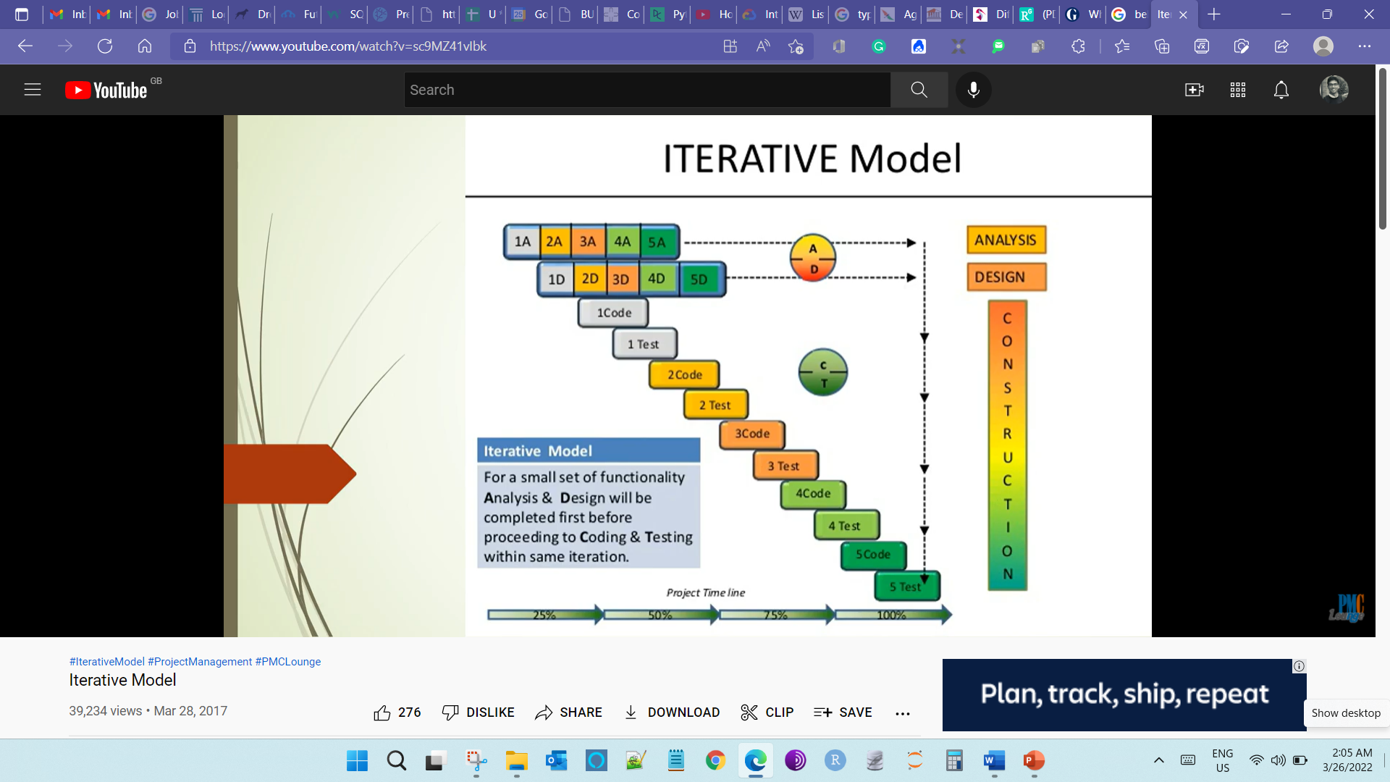
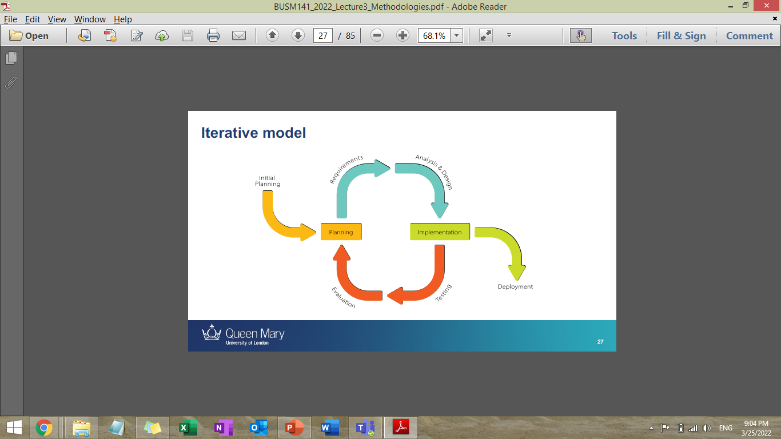
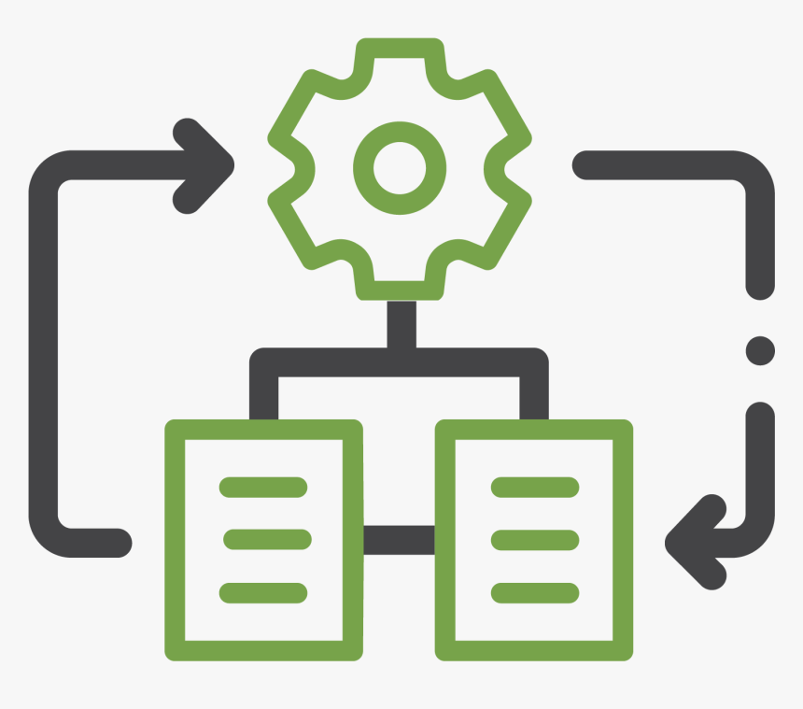
METHODOLOGY
Combination of ITERATIVE + WATERFALL
Repeated cycles (iterative) and in smaller portions at a time
At each iteration, design modifications are made, and new functional capabilities added
Source:
[1] Difference between agile and waterfall approaches | APM
[2] Lecture Slides (Dr. Natalia Efremova), Queen Mary University of London
Notes:
Linear and Iterative, through its lifecycle
Linear: If the previous one done, the next step can go
Iterative: Some steps can be overlapped
Waterfall: Gather all project requirements

Slide 23
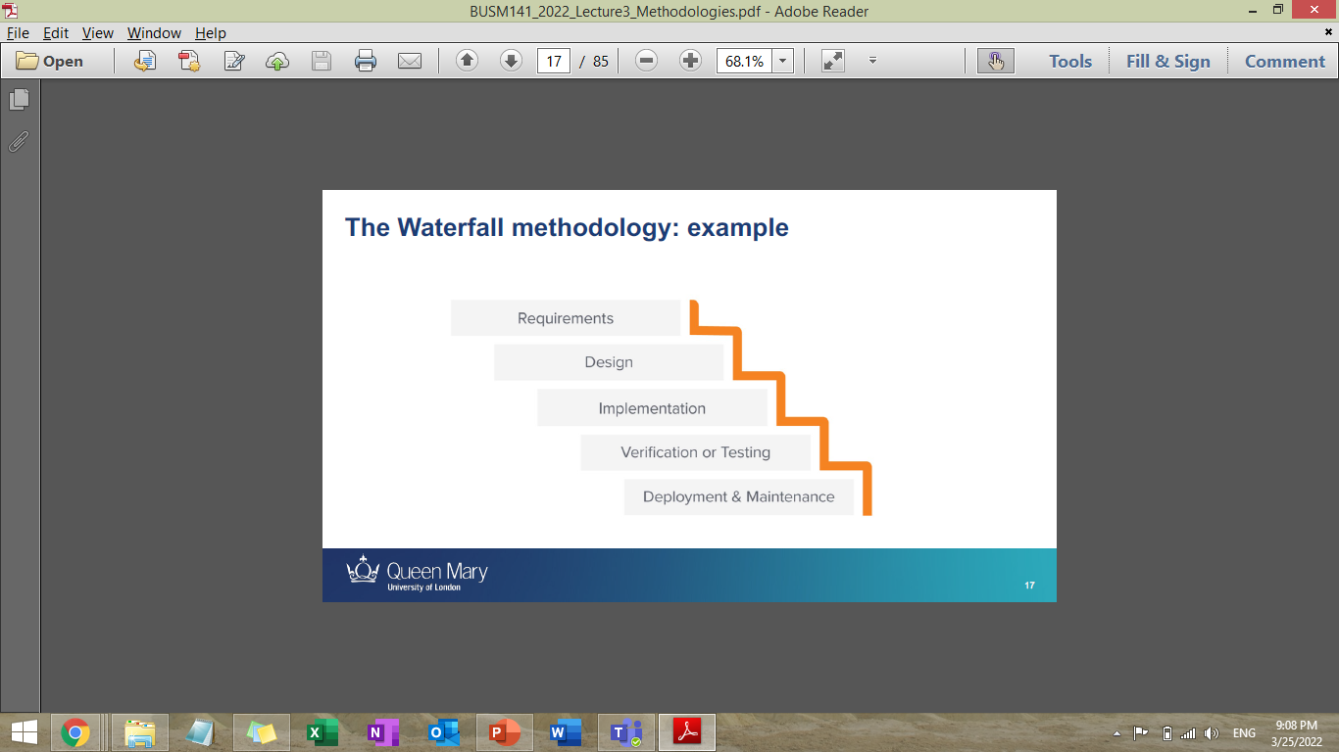
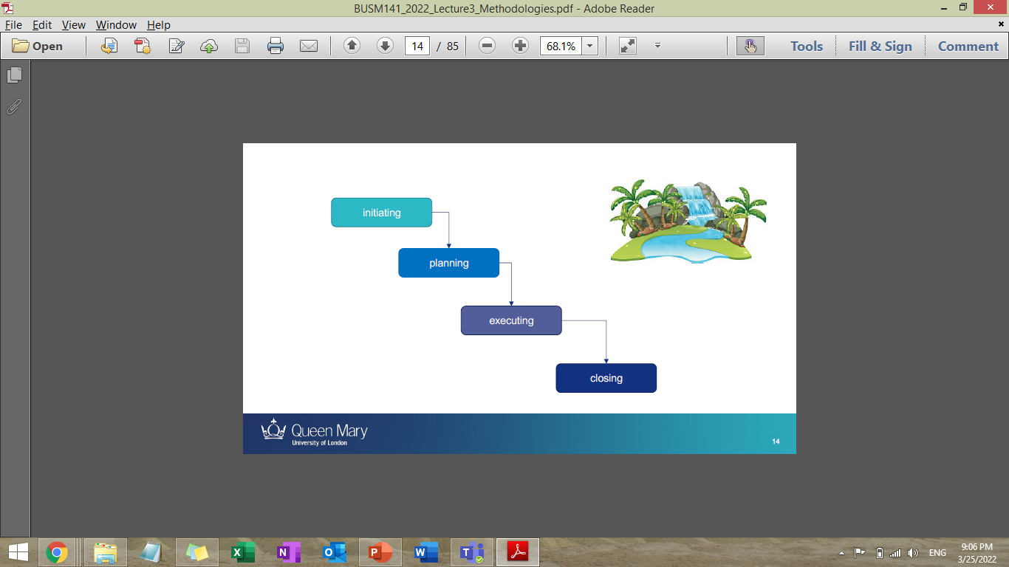
METHODOLOGY
Waterfall -- a sequential development process
Flows like a waterfall through all phases of a project
Each phase completely wrapping up before the next phase begins
Initiating -> Planning -> Executing -> Closing
Source:
[1] Difference between agile and waterfall approaches | APM
[2] Lecture Slides (Dr. Natalia Efremova)

Slide 24
METHODOLOGY – HOW AND WHY
Waterfall -- Phase1
For Government, Farmers, Local Landowner approvals Because in tendering, financial relief application each bureaucratic process/approval will be dependent on previous step
Simpler time form
Iterative -- Phase2 and Phase3
To run multiple tasks concurrently, not heavily dependent on tasks
For Tool, Website Development, some element of Agile as well
Source:
[1] Difference between agile and waterfall approaches | APM
[2] Lecture Slides (Dr. Natalia Efremova)

Slide 25
METHODOLOGY – ROLES

Slide 26
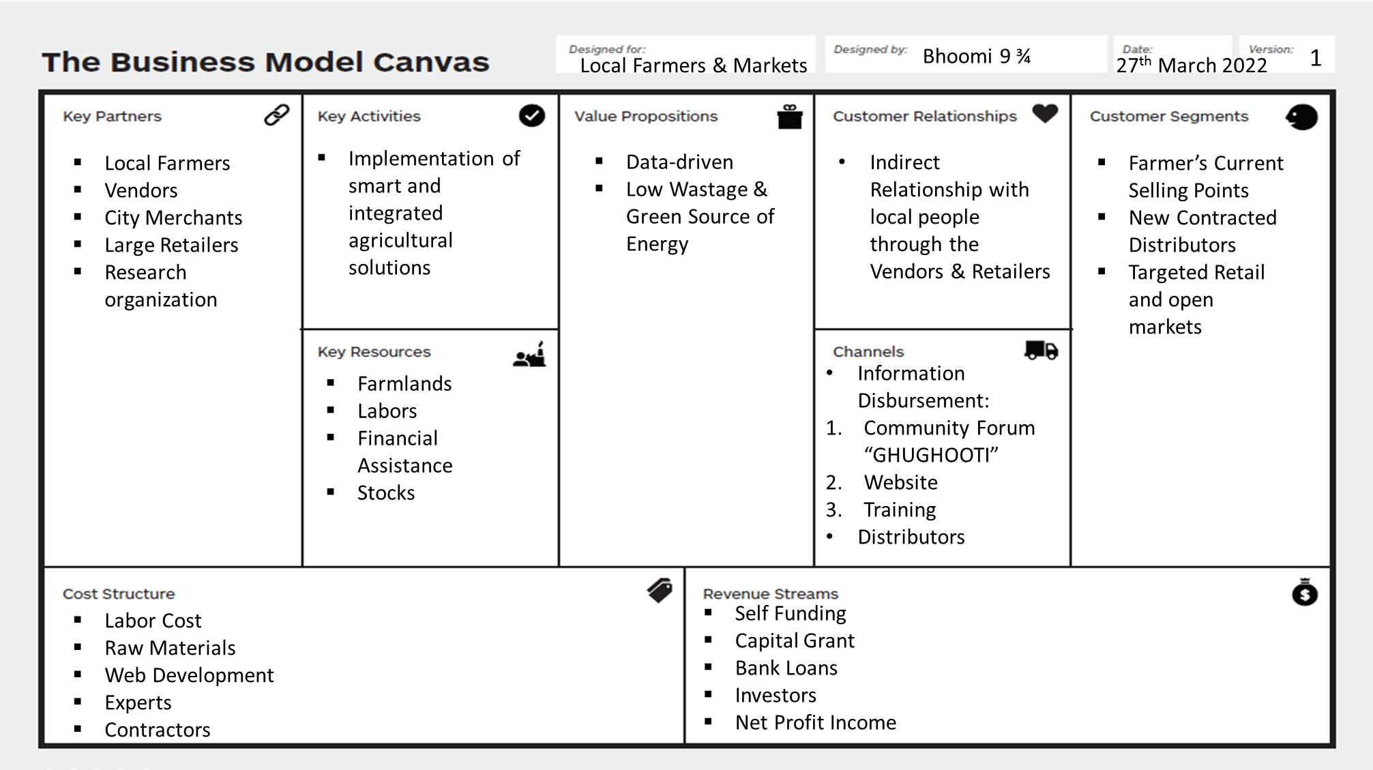
BUSINESS MODEL CANVAS
Scaling and Extending beyond a project implementation

Slide 27
THANK YOU

